Slide 1


Day 22
contact@anubhavtrainings.com
ABAP RESTFUL APPLICATION PROGRAMMING

Slide 2

Agenda – Day 22
Limitations of SAP Business Technology Platform
Why would a customer would go for AoC if they can do S4
What is RAP?
Flow of RESTful Application Programming
Important Tables

Slide 3

Limitations of SAP Business Technology Platform ABAP Environment - Steampunk
It is an offering by SAP in SAP BTP platform as ABAP Platform as a service, which has limited capability.
https://blogs.sap.com/2019/08/20/its-steampunk-now/
We cannot use SAPGUI to connect to this system
We do not have control to install patches and add-on, snote
It is not an environment of any SAP ERP solutions
All the ABAP dictionary objects are marked as non-released
SAP’s actual product is S/4HANA, so all the classical extensions will be carried out in S4 itself.
You cannot create a program type of object
The AOC allows only usage of whitelisted abap statements, we cannot freely use every abap programming keyword.
Note : Eclipse environment can be used to connect to ABAP Environment in SAP Cloud platform

Slide 4
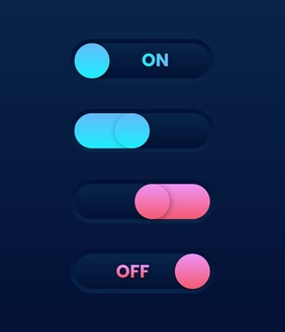
Why would a customer would go for AoC if they can do S4
You want to S/4 to be stable.
Speed of innovation – Yearly 1809,1909 – can you wait this much to innovate?
Cloud first strategy where release cycles are quarterly (weekly, daily)
Products which are pure cloud like S/4HANA Cloud, you don’t get SAPGUI access, in this case if some one want to create new solutions, they have to go for SAP CP.
What is the advantage of AOC over S4
AOC is not a solution(product) – developers to build new solution S/4HANA

Slide 5

Restful ABAP Programming
The ABAP RESTful programming model defines the architecture for efficient end-to-end development of intrinsically SAP HANA-optimized OData services (such as Fiori apps) in SAP Business Technology Platform ABAP Environment. It supports the development of all types of Fiori applications as well as A2X services. It is based on technologies and frameworks such as Core Data Services (CDS) for defining semantically rich data models and a service model infrastructure for creating OData services with bindings to an OData protocol and ABAP-based application services for custom logic and SAPUI5-based user interfaces .
The whole architecture is based on
CDS views – will helps you to create semantically rich data model
Business Object – here is a node inside a tree data structure which is achieved by using root keyword at CDS view level, this is needed only if we want to add transactional capability.
Finally create a service using service definition and service binding
The binding will confirm the Purpose of service – API or Fiori
UI layer with the Fiori app using elements

Slide 6
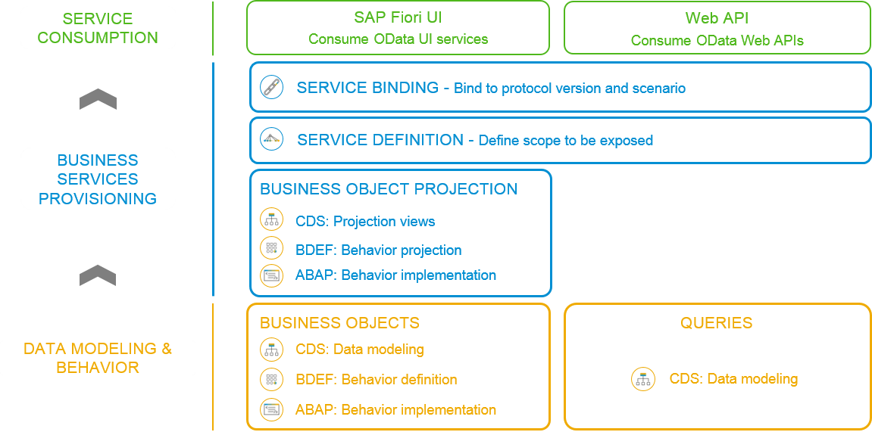
Flow of RESTful Application Programming

Slide 7
Important Tables
CDS Views on these table for ease of access
Database tables
Represents entire aviation tourism
/DMO/CARRIER– Contains all the airline codes
I_Currency
CDS view to access currency codes
/DMO/AGENCY
Agent information website/person who helps
/DMO/CONNECTION– FLIGHT infor from origin to destination
I_Country
Country codes
/DMO/TRAVEL
Trip information
/dmo/flight– given flight for diff. dates
/DMO/CUSTOMER
Customer data who willing to book flights
/DMO/BOOKING
Connecting flights in whole travel

Slide 8

End of Day 22
Trainer: Anubhav Oberoy

Slide 9

Trainer: Anubhav Oberoy

Slide 10
THANK YOU
If you cannot do
great things, do small things in a great way.
Anubhav Oberoy
https://www.anubhavtrainings.com

Slide 11


We’re committed to empower you to be
Most Desirable Resource
through powerful training solutions.
We build the workforce of the future.
250+
Corporate Clients
30,000+
Learners Trained
25000+
Learners Placed
FREE WEBINARS
Sign up for free webinars with industry experts every fortnight!
Enroll Now!
Contact us today!
https://anubhavtrainings.com/

Slide 12




More from AnubhavTrainings.com

